Slide 1
Data Protection
Corporate Computer Security, 4th Edition
Randall J. Boyle & Raymond R. Panko
Chapter 9

Slide 2
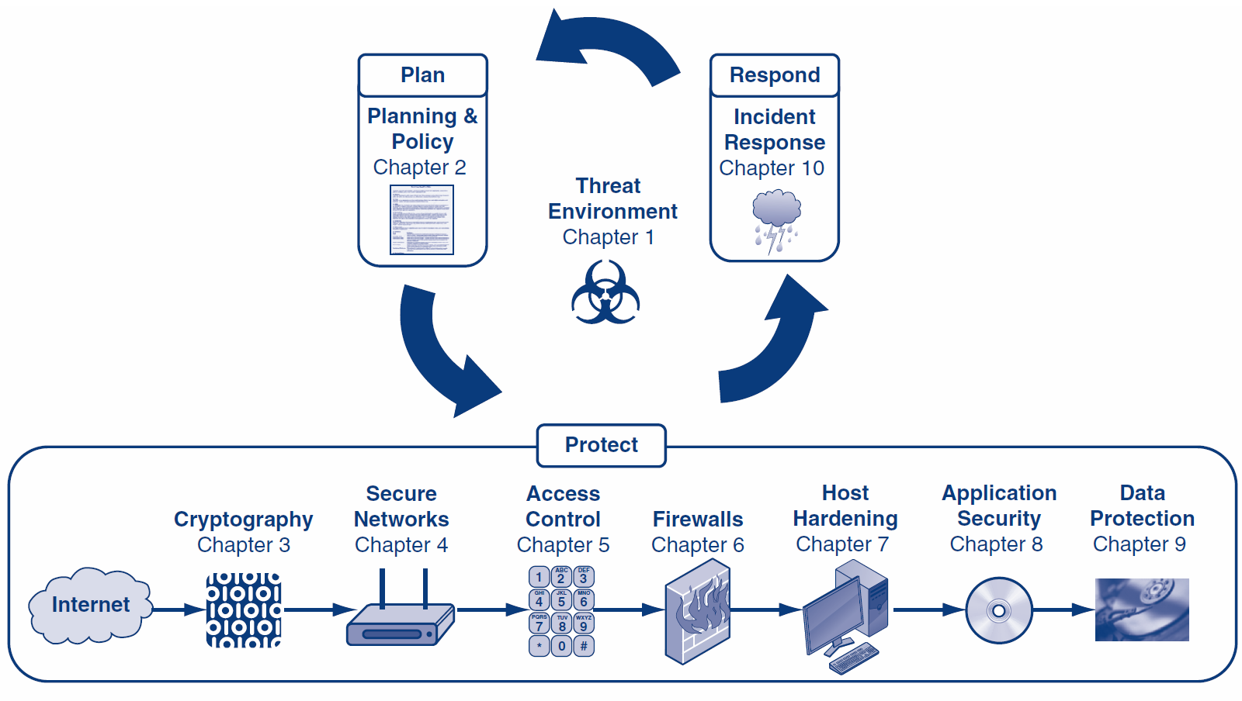

Slide 3
Learning Objectives
Explain the necessity for backup.
Describe backup scope and methods.
Describe the different RAID (redundant array of independent disks) levels.
Explain the need for data storage policies.
Explain database protections.
Explain the need for database access controls, auditing, and encryption.
Describe the difference between data leakage and data theft.
Explain data deletion, destruction, and disposal.
Explain digital rights management (DRM) and how it can prevent data loss.
Notes:
The material in italics will only lightly be touched on. It is assumed you know this material from previous courses.

Slide 4
9.1: Data’s Role In Business
This chapter will primarily focus on securing data while it is being stored
More specifically:
How backup can prevent accidental data loss
How to securely store data in a database
How to prevent data from being taken out of the corporation
How to securely dispose of data

Slide 5
9.1: Data’s Role In Business
Data are the principal elements of any information system
Businesses gather enormous amounts of data
Information for decision making
Data are valuable assets that are core components of a larger corporate strategy
Source code, intellectual property, user data, etc. must all be protected

Slide 6
9.1: Sony Data Breaches
Series of attacks against Sony Corporation
Lost data for 100+ million user accounts
Shut down the PlayStation Network
Subsequent SQL injection attack
1 million usernames and passwords stolen
Passwords stored as plaintext
Included names, email addresses, phone numbers, dates of birth, music coupons, layout of the database, and maps of Sony’s internal corporate network

Slide 7
9.2: Data Protection: Backup
Importance
In an incident, you may lose all data that is not backed up
Threats That Are Addressed by Backup
Mechanical hard drive failure/damage in a fire/flood
Data on lost or stolen computers is not available to the organization
Malware can reformat the hard drive or do other data destruction

Slide 8
9.2: Scope of Backup
Scope of Backup
Fraction of information on the hard drive that is backed up
File/Directory Data Backup
Select data files and directories to be backed up
(Do not forget items on the desktop!)
Not good for programs

Slide 9
9.2: Scope of Backup
Image Backup
Backs up everything and is very slow
Shadowing
A backup copy of each file being worked on is written every few minutes to the hard drive, or to another location

Slide 10
9.2: Full vs. Incremental Backup
Full backups
All files and directories, slow
Incremental Backups
Only records changed since the last backup
Fast, so usually done daily

Slide 11
9.2: Full vs. Incremental Backup
Restoration Order
Restore the full backup first
Then restore incremental backups in the order created
Otherwise, newer files will be overwritten

Slide 12
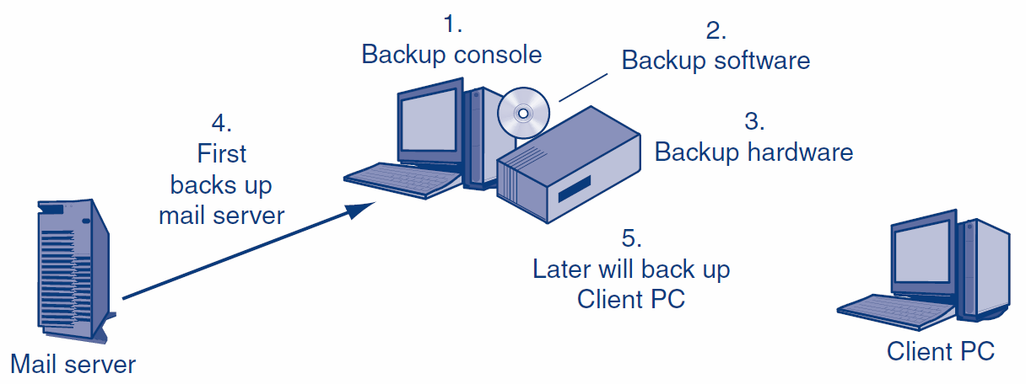
9.2: Centralized Backup
Local backup on individual PCs is difficult to enforce.
Centralized backup provides backup labor and enforcement.

Slide 13
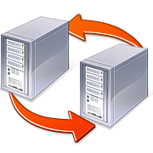
9.2: Backup Technologies
Continuous Data Protection (CDP)
Used when a firm has two server locations
Each location backs up the other in real time
Other site can take over very quickly in case of a disaster, with little data loss
Requires expensive high–speed transmission link between the sites

Slide 14
9.3: Disk Arrays - RAID
RAID – Redundant Array of Independent Disks
Multiple hard drives within a single system
Increased reliability and performance
A single hard drive failure won’t necessarily precipitate data loss
Multiple disks can be written to simultaneously
RAID Levels – Ways of configuring multi-disk arrays

Slide 15
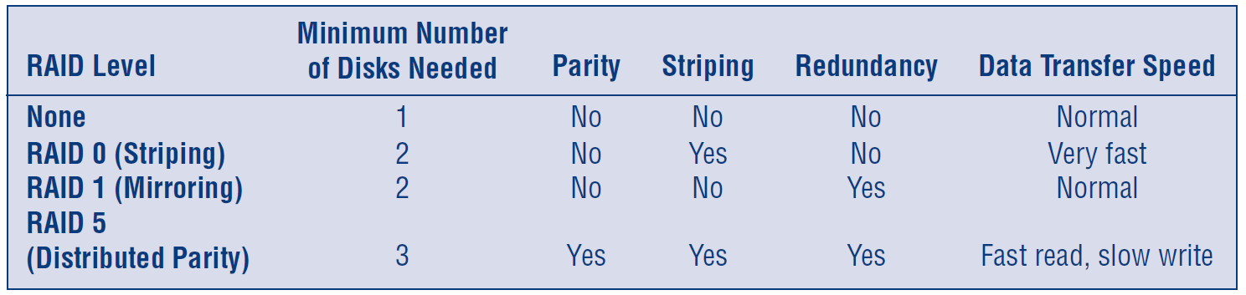
9.3: RAID Levels
Disk striping is the process of dividing a body of data into blocks and spreading the data blocks across multiple storage devices.
Parity computations are used in RAID drive arrays for fault tolerance by calculating the data in two drives and storing the results on a third. The parity is computed by XOR'ing a bit from drive 1 with a bit from drive 2 and storing the result on drive 3.
Notes:
Disk striping is the process of dividing a body of data into blocks and spreading the data blocks across multiple storage devices.
Parity computations are used in RAID drive arrays for fault tolerance by calculating the data in two drives and storing the results on a third. The parity is computed by XOR'ing a bit from drive 1 with a bit from drive 2 and storing the result on drive 3

Slide 16
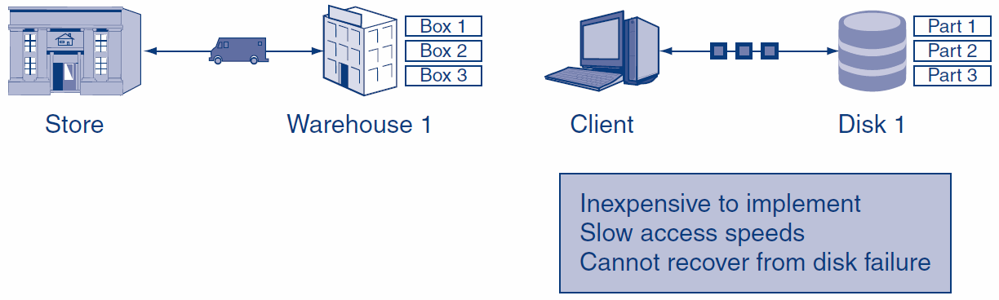
9.3: No RAID
Shipping boxes
Storing Data

Slide 17
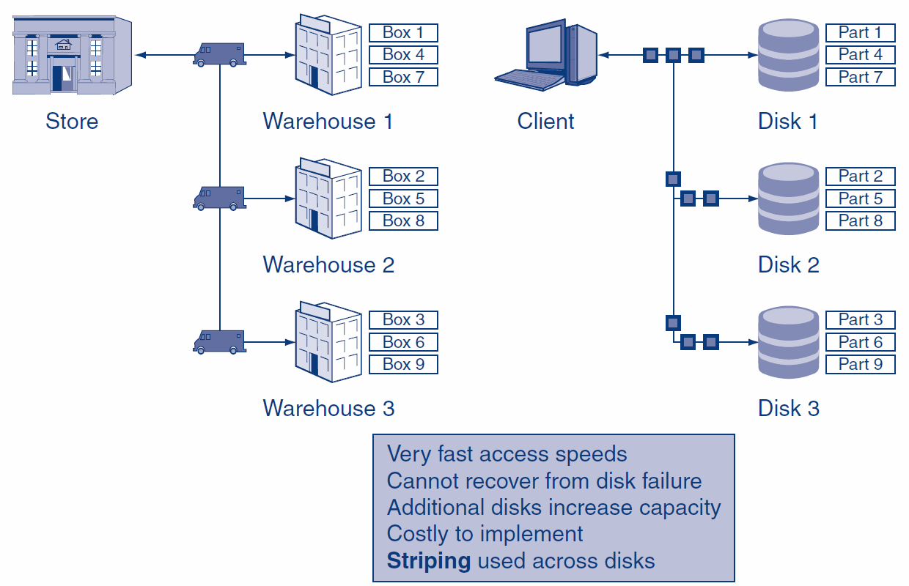
9.3: RAID Level 0 (zero)

Slide 18
9.3: Disk Arrays - RAID
Striping – Writing data simultaneously across multiple disks
Very fast, but no reliability
One disk failure will cause complete data loss
Mirroring – Creating an exact copy of a disk at the same time
Data transfer speeds remain nominal
Virtually no data loss, but more costly to buy additional hard drives

Slide 19
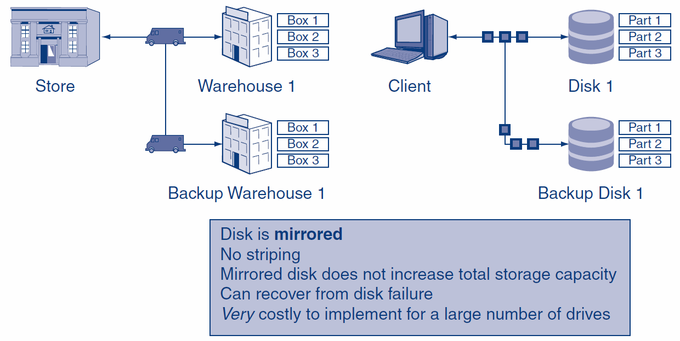
9.3: RAID Level 1

Slide 20
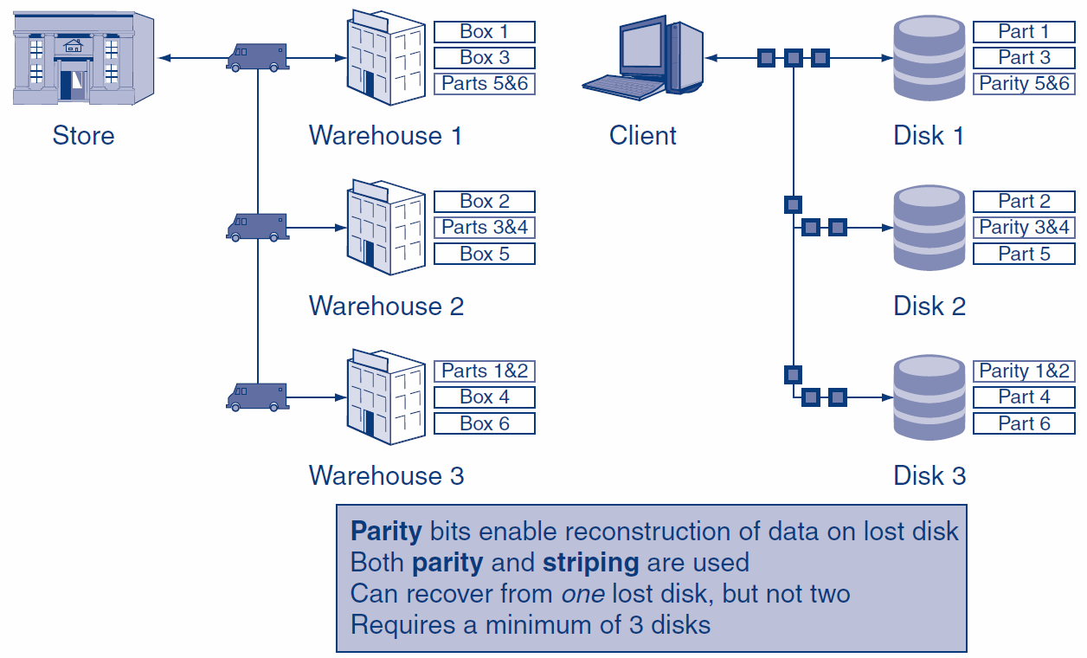
9.3: RAID Level 5
Parity computations are used in RAID drive arrays for fault tolerance by calculating the data in two drives and storing the results on a third. The parity is computed by XOR'ing a bit from drive 1 with a bit from drive 2 and storing the result on drive 3

Slide 21
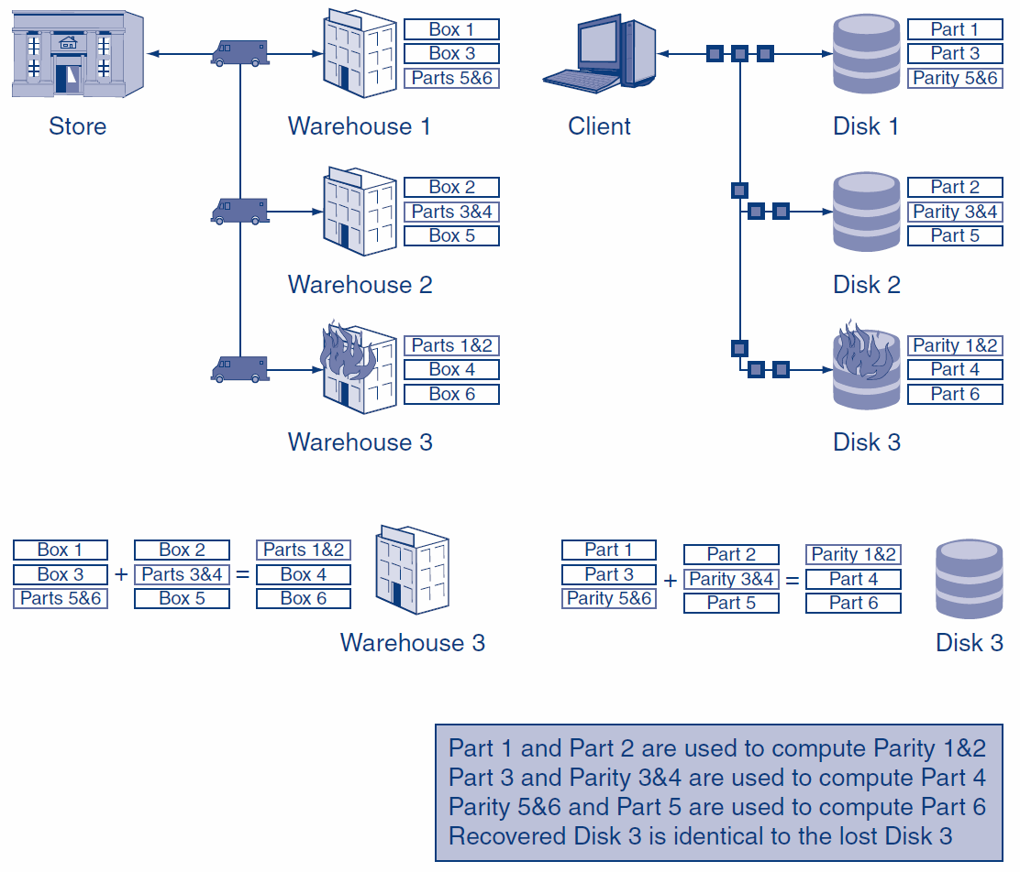
9.3: RAID Level 5 Recovery

Slide 22

9.4: Backup Management Policies
Backup Creation Policies
Understand current system and future needs
Create policies for different types of data and computers
What should be backed up, how frequently, how frequently to test restorations, etc.
Restoration Policies
Do restoration tests frequently

Slide 23
9.4: Backup Management Policies
Media Storage Location Policies
Store media at a different site
Store backup media in a fireproof and waterproof safe until it can be moved offsite
Encryption Policies
Encrypt backup media before moving them, so confidential information will not be exposed if the tape is stolen or lost

Slide 24
9.4: Backup Management Policies
Strong Access Control Policies for Backup Media
Checkouts are rare and therefore suspicious
Checking out media can result in their loss and the damages that come with loss
The manager of the person requesting the checkout should approve the checkout

Slide 25

9.4: Backup Management Policies
Data Retention Policies
There are strong legal requirements for how long certain types of data must be kept
Auditing Policy Compliance
All policies should be audited
Includes tracing what happened in samples of data

Slide 26
Back-up Breach (not in text)
TD Backup Breach
Healthcare Backup Data Breach
Notes:
http://www.reuters.com/article/2011/09/29/us-data-breach-texas-idUSTRE78S5JG20110929

Slide 27
9.5: Database Security
Often used in mission-critical applications
Require additional security precautions
As discussed earlier, avoid SQL injection attacks
Restrict Access to Data
Restrict granularity (level of detail)
Restrict information about DB structure

Slide 28
9.5: Database Access Control
Database Access Control
Restrict access to DBs via DBMS
Rename administrator account, disable guest/public accounts, lowest possible permissions necessary

Slide 29
9.5: Database Auditing
Database Auditing
Collect information about users’ interactions with databases
Policy driven, reflecting legal and regulatory obligations
Audit: logins, changes to the database, warnings, exceptions, and special access

Slide 30

9.5: Data Protection: Encryption
Encryption
Makes data unreadable to someone who does not have the key
Prevents theft of private or trade secret information
May reduce legal liability if lost or stolen data is encrypted
What to Encrypt
Files and directories
Entire disk

Slide 31
9.5: Data Protection: Encryption
Key Escrow
Loss of the key is disastrous
Not like losing a password that can be reset
Key escrow stores a copy of the key in a safe place
Bad if managed by user
Central key escrow on a corporate server is better

Slide 32
9.6: Data Loss Prevention
Data Loss Prevention (DLP)
A set of policies, procedures, and systems designed to prevent sensitive data from being released to unauthorized persons
Data Collection
Most companies collect more data than they can adequately protect

Slide 33
9.6: Data Loss Prevention
Personally Identifiable Information (PII)
Private employee or customer information that can be used to uniquely identify a person
PII includes: Names (full name), personal identification numbers (SSN), addresses (street or e-mail), personal characteristics (photos), and linking information (date of birth)
Data Masking
Obscuring data such that it cannot identify a specific person, but remains useful

Slide 34
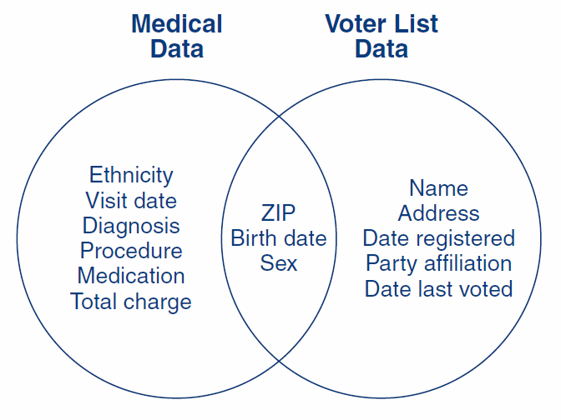
9.6: Re-Identifying Data
Latanya Sweeney, k-anonymity: a model for protecting privacy. International Journal on Uncertainty, Fuzziness and Knowledge-based Systems, 10 (5), 2002; 557-570.
Notes:
For example, William Weld was governor of Massachusetts at that time and his medical records were in the GIC data. Governor Weld lived in Cambridge Massachusetts. According to the Cambridge Voter list, six people had his particular birth date; only three of them were men; and, he was the only one in his 5-digit ZIP code.

Slide 35
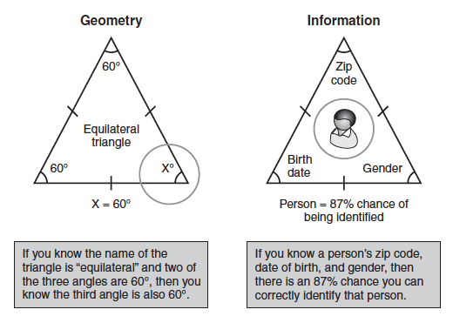
9.6: Information Triangulation

Slide 36
9.6: Document Restrictions
Document Restrictions
Attempt to restrict what users can do to documents
Data Extrusion Management
Attempts to prevent restricted data files from leaving the firm without permission
Watermark with invisible restriction indicators
Traffic analysis to look for unusually large numbers of outgoing files sent by a user
Notes:
Document Restrictions
Attempt to restrict what users can do to documents in order to reduce security threats
Embryonic
Digital Rights Management (DRM)
Prevents unauthorized copying, printing, etc.
May not be able to see parts of documents
Data Extrusion Management
Attempts to prevent restricted data files from leaving the firm without permission
Watermark with invisible restriction indicators
Traffic analysis to look for unusually large numbers of outgoing files sent by a user

Slide 37
9.6: Document Restrictions
Removable Media Controls
Forbids the attachment of USB RAM drives and other portable media
Reduces user abilities to make copies
Perspective
Have proven difficult to enforce
Often reduces functionality in uncomfortable ways
Companies have been reluctant to use them

Slide 38

9.6: Encrypted USB Drive

Slide 39
9.6: Data Destruction
Data Destruction Is Necessary
Backup media are not needed beyond their retention dates if…
a computer is to be discarded
the computer is to be sold or given to another user
Drive-wiping software for hard drives
Reformatting the hard drive is not enough
Shred CDs and DVDs

Slide 40
The End

Slide 41

All rights reserved. No part of this publication may be reproduced, stored in a retrieval system, or transmitted, in any form or by any means, electronic, mechanical, photocopying, recording, or otherwise, without the prior written permission of the publisher. Printed in the United States of America.
Copyright © 2015 Pearson Education, Inc.

